Slide 1
Nucleotide Biosynthesis (Biosynthesis of Purines & Pyrimidines)

Slide 32
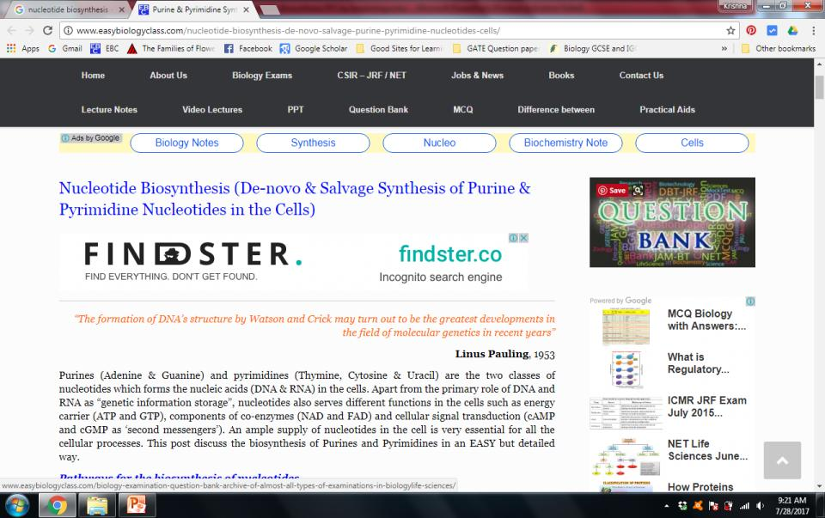
For detailed description of this topic, please click on:
http://www.easybiologyclass.com/nucleotide-biosynthesis-de-novo-salvage-purine-pyrimidine-nucleotides-cells/

Slide 33
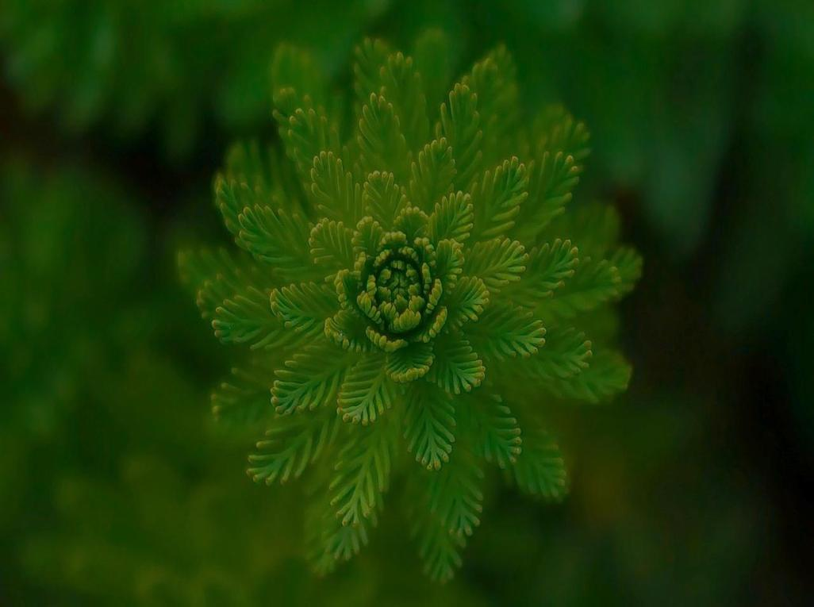
Visit our website: www.easybiologyclass.com for:
Lecture notes
Video tutorials
Biology PPTs
Biology MCQs
CSIR and GATE Study Materials
Job Notifications
Question Bank
Many more…
Our sister concern: www.angiospermtaxonomy.com

Slide 34
For more information, please log on to: www.easybiologyclass.com
For video tutorials : easybiologyclass
Download PPT : Slideshare
Thank You…
E-mail:
easybiologyclass@gmail.com
mail@easybiologyclass.com
visit: www.easybiologyclass.com

